Slide 1
Gathering evidence as you go along
Dr Ben Warwick (Rights for Time 27/4/23)

Slide 2
Scenario
Jon has been involved in a 2 year project
Exciting with some big highlights
Application deadline coming up

Slide 3
Structure
Why collect evidence
Where to collect it
Sources of evidence
Ways to present it

Slide 4
Why collect evidence
Applications
Credibility
Improving/ adjusting your work
Reporting

Slide 5
Where to collect it
Paper and pen!
Bookmarks/ favourites
Word document/ digital note
Email it to yourself

Slide 6
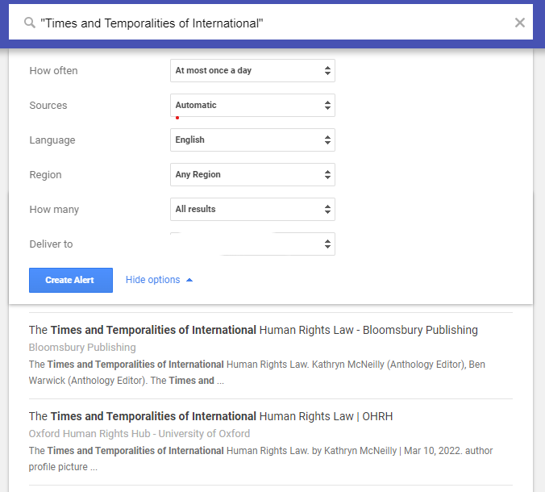
Sources of evidence (i)
Google alerts - https://www.google.com/alerts

Slide 7
Sources of evidence (ii)
Policy Documents
Government
NGO
Regional/ UN bodies
Specific leads/ meetings

Slide 8
Sources of evidence (iii)
Social media
Statistics
Others talking about your work

Slide 9
Sources of evidence (iv)
In person
Service evaluations
Meetings with key stakeholders
Presentations given
Letters
Interviews – radio/ TV

Slide 10
How to present it
Since 2022, over 10,000 people have come into contact with our work on social media platforms.
Our work has been quoted in 5 key policy documents, including by the SLB Ministry.
Around 30% of our service users have reported increased use of their ‘mother tongue’ in the workplace.
The research and photographic outputs reached an estimated audience of 20,000, including in the UK, Peru, China and Pakistan.

Slide 11
Conclusion
Better prepared, better work, and more credibility
Collect it efficiently
Present it with punch!
Questions and discussion

