Slide 1
How to publish your work - openly
Judith Hegenbarth & Suzanne Atkins – Library Services
June 2023

Slide 2
Today
Theory
Publishing as part of the research process
Open Access publishing
Other ways to be ‘open’
Practice
Choosing a journal to publish in
Checking open access routes

Slide 3
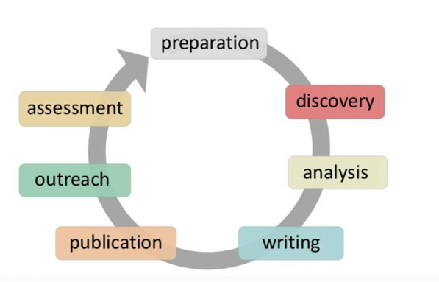
The Research Cycle
Adapted from Jeroen Bosman & Bianca Kramer, Licence CC-BY
Notes:
Shows where in the Research Cycle publication tends to happen. However, don’t see Publication as an isolated task in this sequence – there are many publication questions to be asked at each stage of the research cycle. Recommend planning for publication from the outset. Ask yourself questions such as:
Am I collecting data as part of my research? If so, will I need to put together a Data Management Plan (DMP) so that I can write a Data Access Statement if I publish a journal article?
Do I know what journal I want to publish in? If so, do I have to factor certain requirements around my writing style to fit in with their style guide?

Slide 4
History of scholarly communication
Notes:
Lets begin the story by thinking about how scholarly communication came into being. It was a way of sharing knowledge that had been created, usually via scientific experiment. Began with hypothesis, and recounting the experimental method, and reporting results.
Philosophical Transactions of the Royal Society was established in 1665 by the Royal Society and is the oldest scientific journal in the English-speaking world.
Results and advances in journals presided over by the privileged few.
Much later, academic discourse suggested that this should be more democratic – particularly where research is funded by the public (tax payers)
Open Access publishing became a ‘movement’

Slide 5
Paywallthemovie.com
Notes:
Has anyone experienced the sinking feeling when coming up against a journal paywall? What did you do?
The other part of Open Access is the idea of being free to use and re-purpose material – creative commons licenses are applied. Some publishers encourage authors to sign away their copyright on acceptance, some academics are resisting this with suggested contractual wording (rights retention)
The film (?polemic) looks at the profits made by some of the largest publishers (by charging libraries for subscriptions) and the unpaid labour of researcher/author/reviewer. Asks if this should be done differently.
We are now looking at subscriptions that give not only ‘read’ access but also ‘publish’ access, to pay to make the articles ‘open’.

Slide 6
Open Access at University of Birmingham
See ‘Publishing Open Access’ webpage for more information

Slide 7
Other ways to be ‘open’
Datasets
Software and code
Blogposts, writing for newspapers and ‘practitioner’ publications
Your own profile

Slide 8
Caution
Commercial interests
Participant confidentiality
Notes:
In the UK, Engineering & Physical Sciences Research Council (funder) was the first to mandate sharing of datasets
BUT
Recognition that commercial and privacy issues are still paramount.
FAIR principles perhaps easier to consider:
Findable
Accessible
Interoperable (persistent ids)
Reusable
Can you see any issues here for your own work?

Slide 10
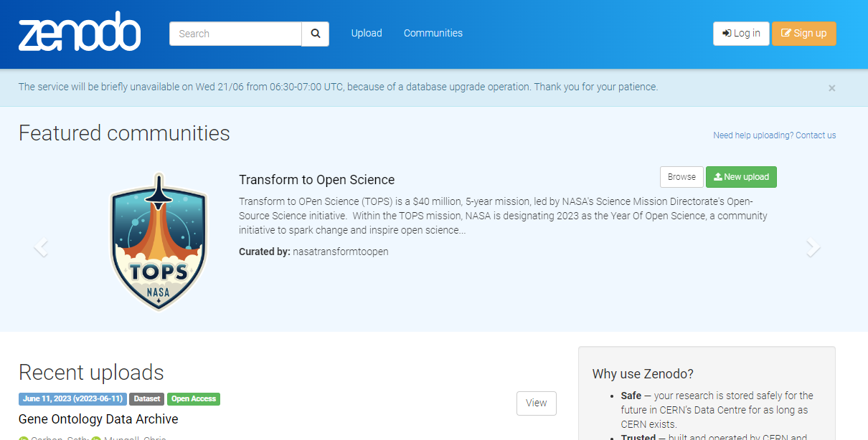
Depositing data or code

Slide 11
Blogs

Slide 14
What next? Publishing your research.
Adapted from Jeroen Bosman & Bianca Kramer, Licence CC-BY

Slide 15
Academic publishing – funder agreements
The benefits of being open are clear, but also:
Many funders, including UKRI (UK Research & Innovation), make Open Access funding a condition of their agreement.
What will you need to do, to publish Open Access?

Slide 16
Choosing a journal venue
Choose a publication venue that is the best fit for the research itself. Use selection strategies, such as:
Noting the journals that have published key articles in your research area.
Speaking to your supervisor/project lead.
Identify (or check for) fully OA journals indexed by Directory of Open Access Journals (DOAJ).
Use Think, Check, Submit checklist for publishing (also use Think, Check, Attend for conferences)
Use journal metrics to inform selection, e.g. Journal Impact Factor (JIF)
However, be wary of relying only on metrics – use responsiblyRead Library Services advice on using metrics to inform your journal publishing strategy first.

Slide 17
Choosing a journal venue
Choose a publication venue that is the best fit for the research itself. Use selection strategies, such as:
Do you want, or are you required, to make your research output available Open Access?
Open Access for journal articles achieved via:
Open Access by publication
Open Access by self-archiving in a repository
Identify (or check for) fully OA journals indexed by Directory of Open Access
Journals (DOAJ): adding filter “Without article processing charges (APCs)”
can be applied to identify diamond open access journals.

Slide 18
Choosing a journal venue
Open Access Scenario 1 – My research is funded, and my funder requires me to publish Open Access
Note: GCRF is funded by UKRI so maybe eligible for block grant funding or permit a policy exception.
Action - Before submission to any journal:
Check our guidance on funders and open access
Many funders now require immediate Open Access for funded articles and conference proceedings either through OA by publication or self-archiving
To ensure you can meet your funder policy, check the Journal you are targeting using our Publishing Open Access page
Use our SciFree Search tool to see if the journal is covered under a University publishing agreement

Slide 19
Choosing a journal venue
Open Access Scenario 2 – My research is not funded, but I would still like to make my research available Open Access
Solution:
Either publish Open Access via a journal a University Transitional or ‘Subscribe to Open’ Agreement or
Self-archiving in a repository
Action - Before submission to any journal:
Check the Journal you are targeting using our Publishing Open Access page
Use our SciFree Search tool to see if the journal is covered under a University publishing agreement

Slide 20
Choosing a journal venue - agreements
Notes:
Image of publishers with UoB publishing agreements

Slide 21
Choosing a journal venue - agreements
Library Services has signed up to over 30 agreements covering 12,000 journals, which allow authors to publish OA at no additional cost
Beneficial because they provide:
More options for everyone (not just funded authors) to publish OA. In most cases you (or UoB co-author) needs to be corresponding author and submit using UoB email address
Other agreements (e.g. Subscribe to Open) may be open to wider authors
But, be aware TAs are all different
Some titles / All titles
Hybrid titles only / Hybrid and Fully OA titles
Use Library SciFree Search tool to confirm:
If title is included in a University publishing agreement
Any eligibility requirements attached to publishing OA in that title

Slide 22
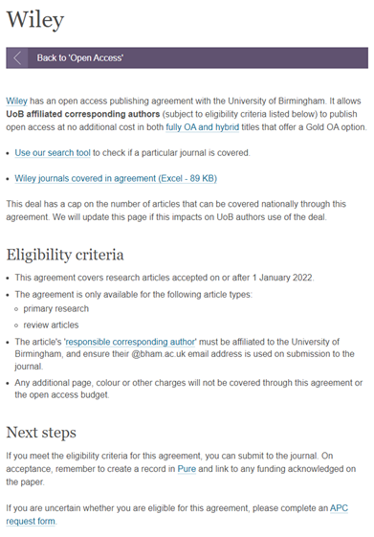
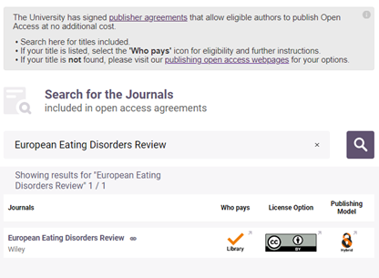
Choosing a journal venue – SciFree search
https://app.scifree.se/birmingham Also linked from UoB OA pages
Search by Journal Title or ISSN
Select the Icon in the 'Who pays' column for more information
Notes:
Demo of SciFree

Slide 23
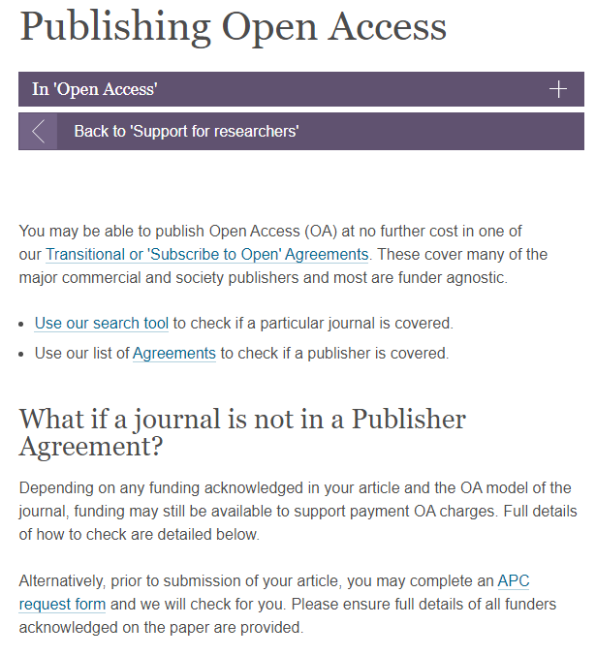
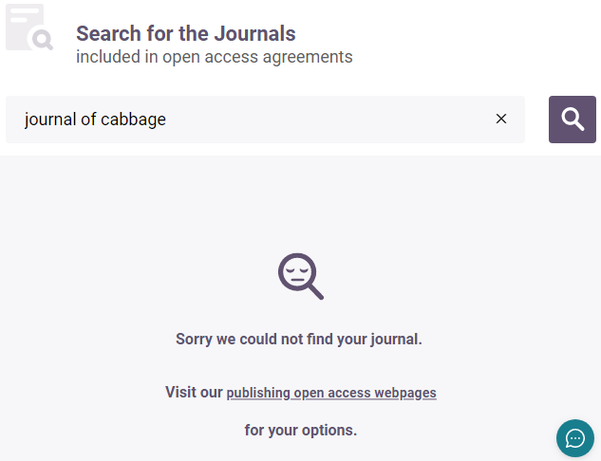
Choosing a journal venue – SciFree search
https://app.scifree.se/birmingham
It is also linked from UoB OA pages
Search by Journal Title or ISSN
If your Journal isn't found – select the link and you'll be taken back to our web pages for further advice
Notes:
Demo of SciFree

Slide 24
Any Questions?

Slide 25
Image Attributions
Images are attributable as follows:​
​Philosophical Transactions Image. Available from Wikimedia Commons: https://commons.wikimedia.org/wiki/File:Philosophical_Transactions_of_the_Royal_Society_cover.jpg (Accessed 26 September 2022)​
Paywallthemovie.com (2018). Paywall the movie https://paywallthemovie.com/ (Accessed: 26 September 2022)​
UK Reproducibility Network (2021) International Reproducibility Networks https://www.ukrn.org/ (Accessed: 26 September 2022)​
Octopus publishing platform (2022) Publication types https://www.octopus.ac/ (Accessed: 26 September 2022)
University of Cape Town, Research Support Hub (2022) Fair Data. https://www.uct.ac.za/research-support-hub/research-data-managing-research-data/fair-data-open-possible-closed-necessary (Accessed: 26 September 2022)​
Hanson, K, Surkis, A & Yacobucci, K. (2012) Data management and sharing snafu in 3 short acts. NYU Health Sciences Libraries. https://www.youtube.com/watch?v=N2zK3sAtr-4. (Accessed 26 October 2022)
Medrxiv. Preprint Archive. https://www.medrxiv.org/ (Accessed 26 October 2022)
eLife. Preprint platform. https://elifesciences.org/ (Accessed 27 October 2022)
FOSTER. What is open peer review? https://www.youtube.com/watch?v=o25ENtTy2vw&t=5s (Accessed 26 October 2022)
Re3Data Homepage (2022)/ https://www.re3data.org (Accessed: 26 September 2022)​
Engineering Archive Homepage (2022) https://engrxiv.org/ (Accessed: 26 September 2022)​
Zenodo Homepage (2022) https://zenodo.org/ (Accessed: 26 September 2022)
Github Homepage (2022) https://github.com/ (Accessed: 26 September 2022)​
ORCID Homepage (2022) https://orcid.org/ (Accessed: 26 September 2022)​
Kramer, Bianca, & Bosman, Jeroen. (2018, January 14). Rainbow of open science practices. Zenodo. https://doi.org/10.5281/zenodo.1147025 (Accessed: 26 September 2022)​
​Other images from Pixabay (using Creative Commons CC0 licence)

